Slide 1
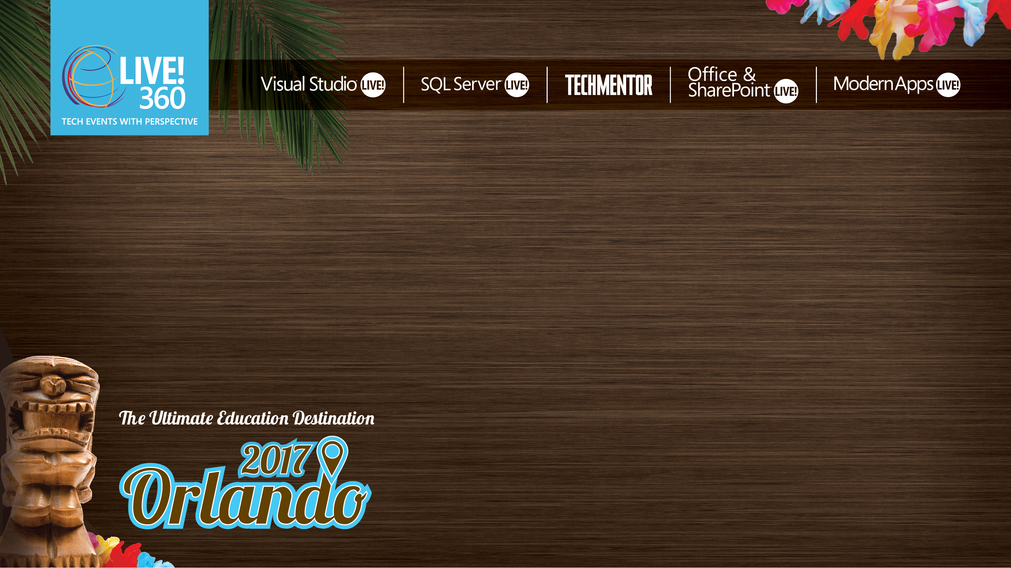
Modern App User Experiences
Kevin Ford
Mobile Practice Lead,
Magenic
Level: Intermediate

Slide 2
Presentations and Demos Available At:
https://github.com/Bowman74/MALModernUIDeepDive

Slide 3
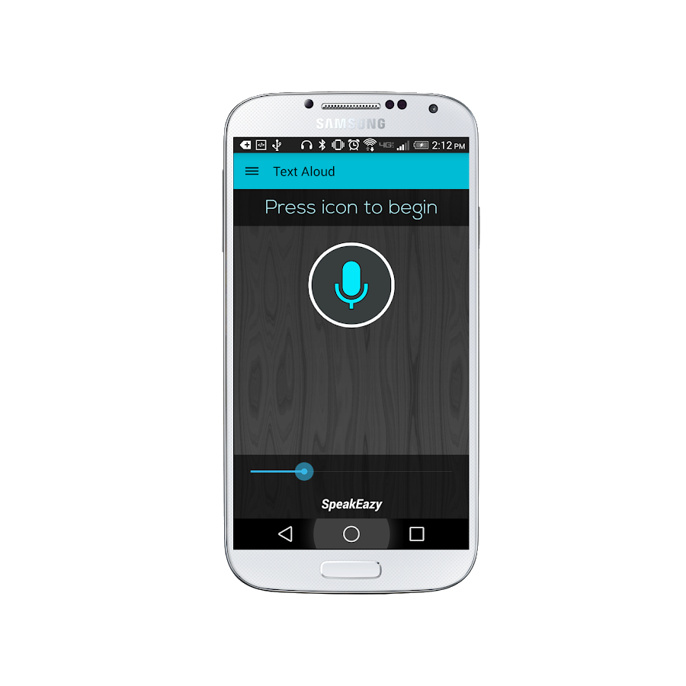
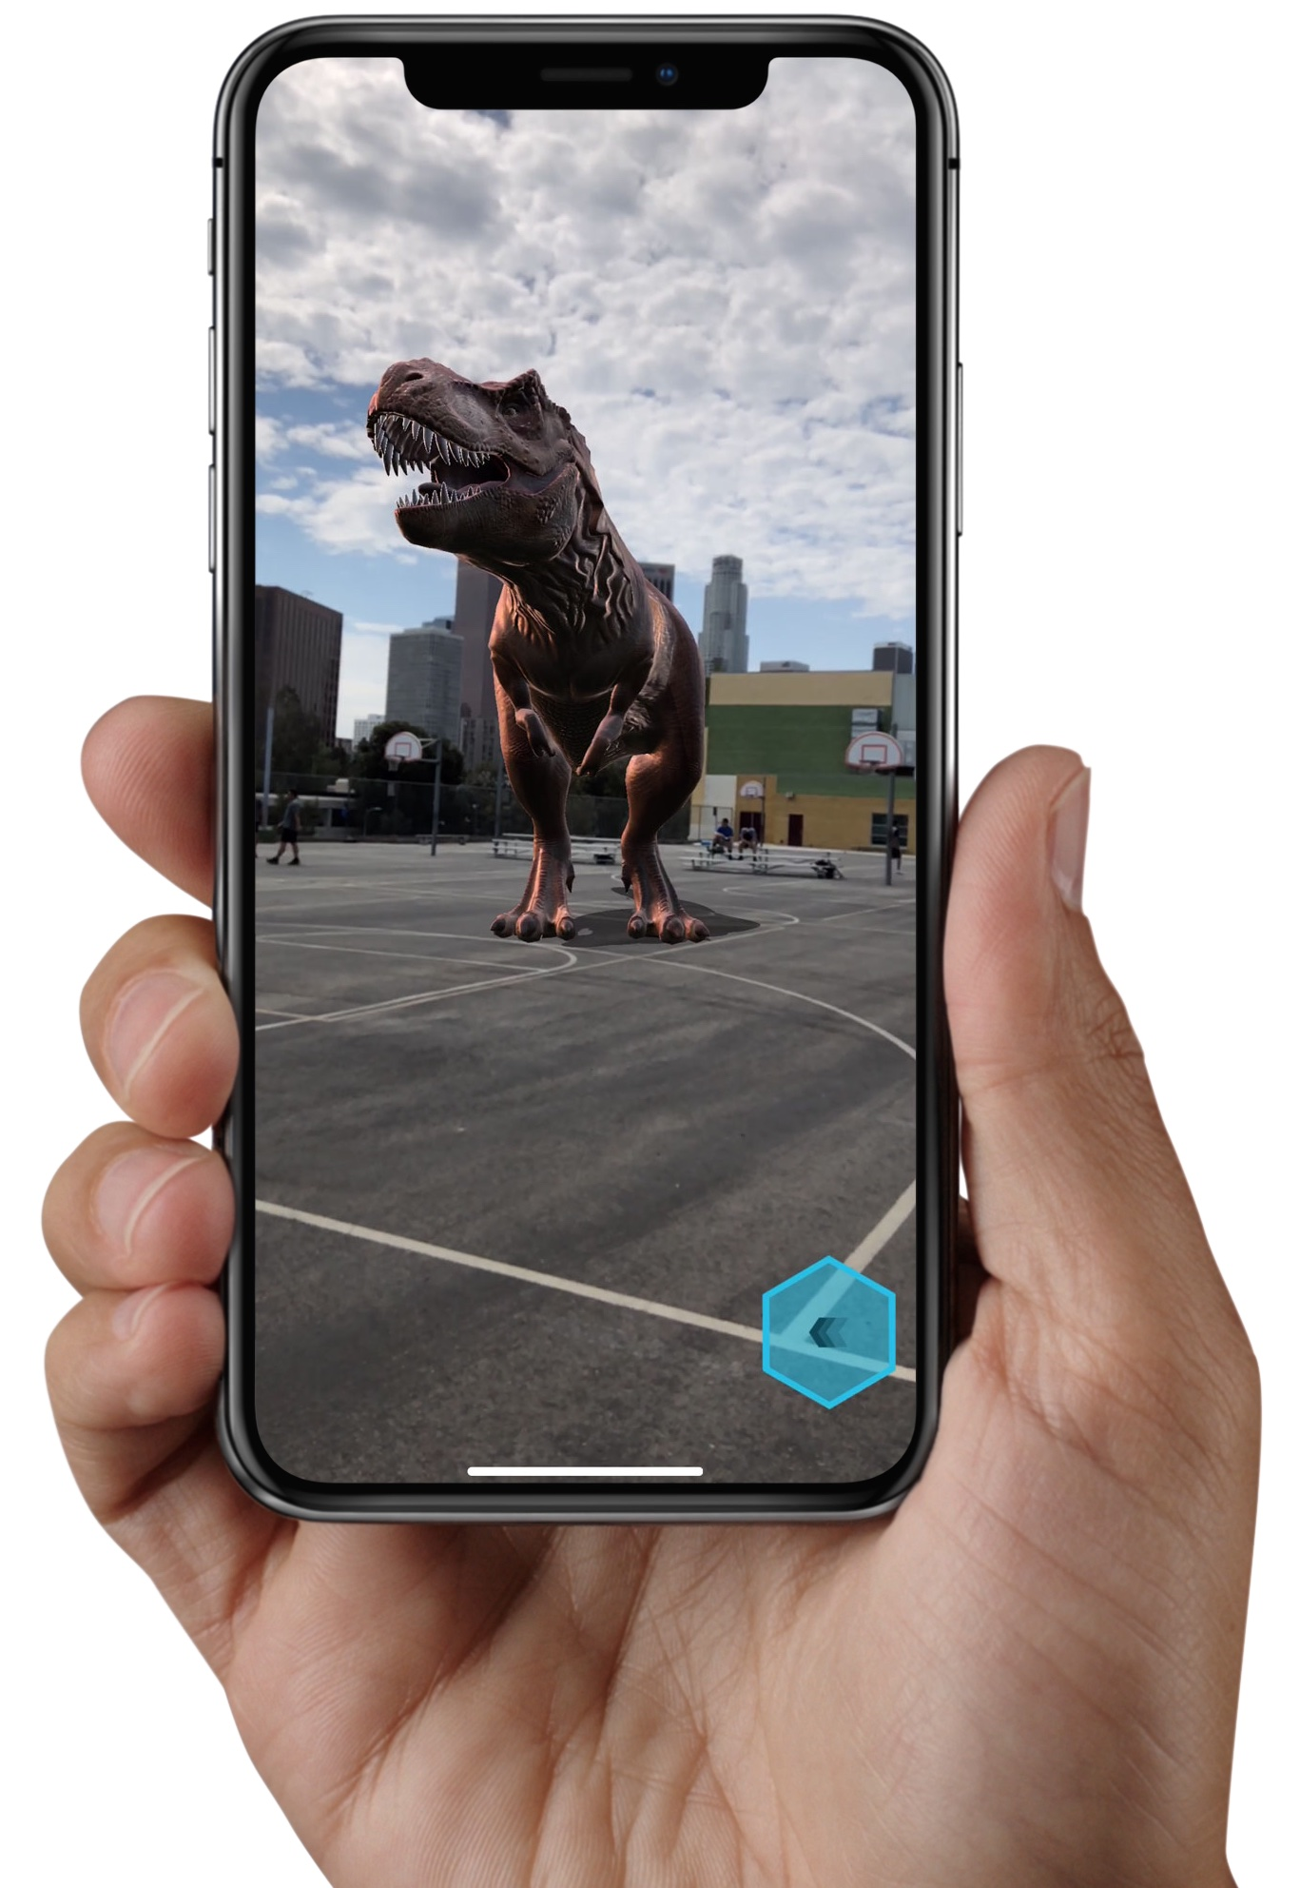
Emerging technologies and patterns to interact with

Slide 4
How AI is enabling this…
New interaction methods require machine understanding
Several Platforms offer these services
AI is now accessible
Don’t require deep AI expertise
Pre-made models

Slide 5
Azure offerings around cognitive services
Bing Entity Search
Speaker Recognition
Computer Vision
Speech
Content Moderator
Language Understanding (LUIS)
Custom Vision
Text Analysis
Face
Translator Text
Notes:
Entity Search –find relative entities (famous people, movies, places) compared to search teams. Allows for categorization
Computer Vision – Understand contents of images. (Handwriting, typed text, celebrities, video analysis)
Content Moderator – Objectional content filter
Custom Vision – Similar to computer vision but can you can train your own models
Face - Face recognition
Speaker Recognition – report who in particular is speaking – authentication
Speech – Recognize what is being said
Language Understanding – understand the INTENT of what is being asked for
Text Analysis - General Purpose understanding what is being typed and what is felt. Even been on a call with a bot and become mad about it…
Translator Text – Translate languages and give alternate explanations to what is being displayed.

Slide 6
Ways to interact with Azure cognitive services
Client APIs
Not available for all platforms
Not always a x-platform design
REST API

Slide 7
Format of the REST API URL
Language Understanding - Custom Service
https://eastus2.api.cognitive.microsoft.com/luis/v2.0/apps/serviceGuid/?subscription-key=serviceKey&timezoneOffset=-360&q={HttpUtility.UrlEncode(requestText)}"
Speech Recognition – Standard Service
https://westus.stt.speech.microsoft.com/speech/recognition/conversation/cognitiveservices/v1?language=en-US&format=simple
Both use POST

Slide 8
Securing standard REST APIs
Using the key directly
request.Headers.Add("Ocp-Apim-Subscription-Key", Url.SpeechKey);
Getting a token
private async Task<string> FetchTokenAsync(string fetchUri, string subscriptionKey)
{
using (var client = new HttpClient())
{
client.DefaultRequestHeaders.Add("Ocp-Apim-Subscription-Key", subscriptionKey);
UriBuilder uriBuilder = new UriBuilder(fetchUri);
var result = await client.PostAsync(uriBuilder.Uri.AbsoluteUri, null);
return await result.Content.ReadAsStringAsync();
}
}
request.Headers.Add("Authorization", $"Bearer {accessToken}");
Token service has to use URL of same data center

Slide 9
Sending parameters to the service
Depends on service type
Language understanding: text on parameter
Image: binary stream - application/octet-stream
Speech recognition: binary stream - audio/wav; codec=audio/pcm; samplerate=16000
May even be able to live stream

Slide 10

LUIS Digging in - Key Concepts
Entity
Intent
App -> Model
Training
Utterance
Role
Notes:
Entity – a list of replaceable elements that tell you something about what is being asked for
Intent – the type of interaction the user wants I want a new project
App – A collection of entities, intents and other items used to create a domain specific model
Training – the process of ensuring that the understanding of the conversation is what you expect
Utterance – input from the user that the app will interpret
Roles – How an entity is being used in an utterance. For example is a city a start location or destination?

Slide 11
LUIS – What’s coming back
{
"query": ”Create a new bug",
"topScoringIntent": {
"intent": ”Create New",
"score": 0.95231
},
"entities": [
{
"entity": "30",
"type": ”ItemType",
"startIndex": 13,
"endIndex": 15,
"resolution": {
"value": ”bug"
}
} ],
"sentimentAnalysis": {
"label": "neutral",
"score": 0.5
}
}

Slide 12
Demo – Setting up Luis and using it in an app
https://www.luis.ai/applications/

Slide 13
Conversational UIs - Voice

Slide 14
When to Use Voice?
Similar scripted and intent based flow as text based conversational UIs
When the user can’t look at or touch the device
When the device is within listening distance
When the environment is appropriate for listening
When you understand how your audience communicates

Slide 15
Demo – Coding Azure Voice

Slide 16
Image Recognition
Notes:
This is getting into the world of machine learning

Slide 17
When to Use Image Recognition?
There is access to a camera or digital photo library
When objects in the real world can provide information
When the evaluation of those objects fits the device limitations
(CPU or network)
Sufficient image quality
Hard to spot items / Patterns

Slide 18

Simple Model Using Azure Computer Vision
Image of handwritten request
Converted text request
Converted text request
Evaluation of text
Application Logic

Slide 19
Demo – Coding Azure Computer Vision

Slide 20
Tying it in with a Bot
Notes:
Web App bot – Bot deployed in PAAS Web App service
Bot channels registration – use when you want to host a bot wherever.
Functions bot - Bot deployed in PAAS functions App service

Slide 21
Creating our Bot

Slide 22
Design Considerations
Operator, OPERATOR!!!! Give me a person!!!!
Do you need speech?
Does it do too much?
Is it intuitive and easy?
Is it available where the users want it?

Slide 23
Slightly different paradigm
Notes:
Instead of a flow of screens we have a flow of messaged

Slide 24
It’s not just text

Slide 25
Bot Concepts
Activity
Channel
Turn
State
User State
Conversation State
Private State
Notes:
Activity - Interaction between a person and a bot
Channel – Communication front end such as SMS or Facebook
Turn - User sending information to the bot and getting it back
State – ability to remember something about a user or conversation. For example, the user’s name State is stored in key/value pairs
User state – state about a specific user, spans turns and conversations
Conversation state – state during a conversation available to any user
Private Conversation State – state scoped to a user in a conversation

Slide 26


The most basic Bot
Configuration
XYYBot.bot
Startup.cs
Channel
OnTurnAsync
XYZBot.cs
IBot

Slide 27
Keeping Information Turn to Turn
IStatePropertyAccessor
public class XYZBotAccessors
{
public XYZBotAccessors(UserState userState)
{
UserState = userState ?? throw new ArgumentNullException(nameof(userState));
}
public IStatePropertyAccessor<UserProfile> UserProfile { get; set; }
public UserState UserState { get; }
}

Slide 28
Setting up an Assessor
Startup – ConfigureServices(IServiceCollection services)
IStorage storage = new MemoryStorage();
UserState userState = new UserState(storage);
services.AddSingleton<XYZBotAccessors>(sp =>
{
return new XYZBotAccessors(userState)
{
UserProfileAccessor = userState.CreateProperty<UserProfile>(“SomeKeyString”),
};
});

Slide 29
Getting and saving information
Injected into the XYZBot.cs
public XYZBot(XYZAccessors accessors)
Get current information
UserProfile userProfile = await _accessors.UserProfileAccessor.GetAsync(turnContext, () => new UserProfile());
“Save” Information
await _accessors.UserProfileAccessor.SetAsync(turnContext, userProfile);

Slide 30
Demo – A bot that saves user state

Slide 31
Dialogs
ContinueDialog
OnTurnAsync
Conversation Organization
BeginDialog
WaterfallDialog
UserInfo dialog
What is your name?
DialogSets
What is your id?
Prompts
ResumeDialog
Child Dialog

Slide 32
Types of Dialogs

Slide 33
Waterfall Dialogs
Series of steps
return new WaterfallStep[]
{
GetNameStepAsync,
NameConfirmStepAsync,
GetAdoIdStepAsync,
AdoIdConfirmStepStepAsync
};
Continue executes next one in sequence

Slide 34
Waterfall Step
Handles the execution of a single step
private static async Task<DialogTurnResult> GetNameStepAsync(WaterfallStepContext stepContext,
CancellationToken cancellationToken)
{
return await stepContext.PromptAsync("name", new PromptOptions
{ Prompt = MessageFactory.Text(”What is your name?") }, cancellationToken);
}
Complete step by
Showing another dialog (PromptAsync)
Continuing dialog to next step (ContinueDialogAsync)
Replace dialog (ReplaceDialogAsync)
End the dialog (EndDialog)

Slide 35
Demo – How about them bot dialogs?

Slide 36
Key Concepts
Entity
Intent
App -> Model
Training
Utterance
Role
Notes:
Entity – a list of replaceable elements that tell you something about what is being asked for
Intent – the type of interaction the user wants I want a new project
App – A collection of entities, intents and other items used to create a domain specific model
Training – the process of ensuring that the understanding of the conversation is what you expect
Utterance – input from the user that the app will interpret
Roles – How an entity is being used in an utterance. For example is a city a start location or destination?

Slide 37
LUIS Model Development
https://www.luis.ai/applications
Plan
Setup Intents and Entities
Train
Publish
Test
Prebuilt Domains
Model

Slide 38
Bots and natural language
Used when there is a asymmetric flow
Understand user’s intent
Get off my lawn!
Nature Language
Not a certain as a guided flow
Intent
Bot
Can be used to determine what to do next
Can be called directly from the bot

Slide 39
Demo - The LUIS Portal

Slide 40
Configuring the bot
Primary configuration in bot file
{
"appId": ”Some Id",
"authoringKey": ”Some Key",
"version": "0.1",
"region": ”Some Region",
"type": "luis",
"name": "ModernAppsLiveLanguage",
"id": "5"
}
Requires nuget package

Slide 41
Create a service
public class BotServices
{
public BotServices(BotConfiguration botConfiguration)
{
var service = botConfiguration.Services.Single();
var luis = (LuisService)service;
if (luis == null)
{
throw new InvalidOperationException("The LUIS service is not configured correctly in your '.bot' file.");
}
var app = new LuisApplication(luis.AppId, luis.AuthoringKey, luis.GetEndpoint());
var recognizer = new LuisRecognizer(app);
this.LuisServices.Add(luis.Name, recognizer);
}
public Dictionary<string, LuisRecognizer> LuisServices { get; } = new Dictionary<string, LuisRecognizer>();
}

Slide 42
Use the service
Add to startup
services.AddSingleton(sp => new BotServices(botConfig));
Call during turn
var recognizerResult = await _services.LuisServices[LuisKey].RecognizeAsync(turnContext, cancellationToken);
var topIntent = recognizerResult?.GetTopScoringIntent();
if (topIntent != null && topIntent.HasValue && topIntent.Value.intent != "None")
{
// Do stuff based off of the intent
}
Else
{
// We don’t understand what they want
}

Slide 43
Bot Channels- Text

Slide 44
Demo – Hooking up to a SMS channel and Luis

Slide 45
Augmented Reality

Slide 46
Lions and Tigers and Bears, oh my!
Virtual Reality
Augmented Reality
Mixed Reality
Notes:
https://www.quora.com/What-is-the-difference-between-virtual-reality-augmented-reality-and-mixed-reality

Slide 47
Mobile Options
ARCore
ARKit
ARCore

Slide 48
ARKit
More mature than ARCore
iOS Only
A9 Processor or later
Proper lighting

Slide 49




Visual Inertial Odomentry
World Mapping/Tracking
Done for you
Persist beyond sessions
Camera
Accelerometer

Slide 50
Scene Understanding
Plane Detection
Hit Testing
Light Estimation
Notes:
Plane detection – detecting horizontal and vertical surfaces
Hit-Testing – where objects are in a scene
Light estimation – detect ambient light levels so objects can be displayed with proper shading

Slide 51
ARKit Structure
App
ARKit
SceneKit
AVFoundation
CoreMotion
SpriteKit
Metal
Notes:
ARKit tracks the world
Use SceneKit, spriteKit and Metal to change the world

Slide 52
ARSCNView
Basic Object for SceneKit
IARSCNViewDelegate
sceneView = new ARSCNView
{
Delegate = this
};
var configuration = new ARWorldTrackingConfiguration
{
PlaneDetection = (ARPlaneDetection.Horizontal | ARPlaneDetection.Vertical),
AutoFocusEnabled = true
};
sceneView.Session.Run(configuration);

Slide 53
PlaneAnchor
Detected Surface in the world
Can change as ARKit learns more
Introduced in DidAddNode
Updates in DidUpdateNode
Dimensions and position for plan

Slide 54
PlaneAnchor && SCNPlane
PlaneAnchor
SCNNode

Slide 56
Demo – Basic Plane Detection

Slide 57
SpriteKit
IARSKViewDelegate
SKSpriteNode
Can use user interaction to change world
Sprites can be animated

Slide 58
Demo – Adding Sprites

Slide 59
Q & A
https://github.com/Bowman74/MALModernUIDeepDive

